Slide 1
COMP 8567 Advanced Systems Programming Introduction to UNIX Fall 2023 Dr. Prashanth Ranga

Slide 2
COMP 8567- Advanced Systems Programming Course Outcomes https://ctl2.uwindsor.ca/cuma/public/courses/pdf/ee1b450a-23a6-4635-b0c6-40a47a21331f
At the end of the course, the successful student will know and be able to:
Apply OS concepts to design algorithms to solve systems programming problems in a variety of different systems, such as Unix/Linux environments.
Correctly define systems programming problems and identify and apply appropriate solutions approaches.
Design and implement solutions that use the hardware and/or kernel services to solve systems programming problems involving the latest computing technologies.
Interpret informal written descriptions of systems programming problems, and create clear, formal design specifications from them.
Identify the contributions of open-source communities, e.g.. for Linux, and communicate the responsibility of software developers to respect licensing restrictions.
Write reports and software documentations for problems and solutions to be used by others.
Recognize and identify potential growth areas in operating systems’ use and propose original ideas to create future applications

Slide 3
COMP 8567 – List of Topics
1. Introduction to UNIX
2. Advanced C programming techniques
3. Unix Input/Output
4. Process Management and Control
5. Signals
6. Inter Process Communication (Pipes)
7. Unix Shells
8. Multithreading
9. Client-Server applications

Slide 4
Evaluation
10 labs 15%
4 Assignments 20%
Test1 20%
Test2 25%
Project 15%
Participation 5%

Slide 5
Labs
The system will not accept/permit submissions beyond the due-date and time.
You need to include comments explaining the working of your program
Students are permitted to upload files only once
Turnitin similarity reports will be enabled for all lab submissions and students will be able to access the similarity report after submission.
Professor/GA reserves the right to seek clarification from students when the similarity scores are abnormal
Note: This applies to labs/assignments/project and any other related submission

Slide 6
Assignments
You are required to create a 10-15 min video explaining the execution and working of your assignment solution and submit a link.
The system will not accept/permit submissions beyond the due-date and time.
You need to include comments explaining the working of various modules of your solution.
You are required to follow the submission instructions very carefully (reach out to the Professor if you have any questions)
Students are permitted to upload files only once
Turnitin similarity reports will be enabled

Slide 7
Project
You can work alone or in teams or two members
In case of teams, both students must be from the same section
Project work will be evaluated through demo and viva
In case of teams, project work will be evaluated individually (and separately) for each team member
The system will not accept/permit submissions beyond the due-date and time.
You need to include comments explaining the working of various modules of your solution.
You are required to follow the submission instructions very carefully (reach out to the Professor if you have any questions)
Turnitin similarity reports will be enabled

Slide 8
Test 1 and Test 2
Tests will be open book (but NO DEVICES)
No laptops, cell phones, or any other electronic equipment (barring calculators)
You are permitted to carry ANY relevant printed material to the test:
Notes, Textbooks, Reference Books, Linux Manual etc.
Combination of MCQs and T/F questions

Slide 9
Plagiarism
Your work will be compared with all other submissions (all three sections) manually and also with Turnitin.
Do not share your work with anyone.
Sharing work is equally an academic offense (or is considered more serious)
The Professor and the GAs reserve the right to seek clarification from students based on the similarity report or in cases of reasonable suspicion.

Slide 10
Introduction to Unix –Outline
Connecting to the Remote Linux Desktop
The Role of Operating Systems
Architecture of the Unix Operating System
GNU
History of Unix
Other implementations of UNIX
Shells
File System
Input Output
Process and Process ID
Signals
Pipes
System Calls and Library Functions
Conclusion and Summary

Slide 11
Remote Desktop
Remote Desktop via a Web Browser
http://nx.cs.uwindsor.ca
Since the School of Computer Science has a NoMachine Enterprise license, the cs.uwindsor.ca remote desktop can be accessed directly from the browser through the link provided! This method of remote access requires neither the NoMachine client nor the VPN client.
Download the App (Recommended)
https://www.nomachine.com/download/download&id=8

Slide 12
Sample C Program (welcome.c)
# include <stdio.h> //welcome.c
main()
{
printf(“\nWelcome to COMP 8567\n”);
}
$ gcc -o welcome welcome.c
$ ./welcome

Slide 13




Role of Operating Systems
All operating systems provide services for programs they run.
Typical services include:
executing a new program,
opening a file,
reading a file,
allocating a region of memory,
getting the current time of day,
Hardware
– and so on.
Operating System
Applications

Slide 14
Major Software Components of OS
Process Management
Memory Management (Primary Memory)
File Management (Secondary Memory)
I/O Management
Network Management
Security Management

Slide 15
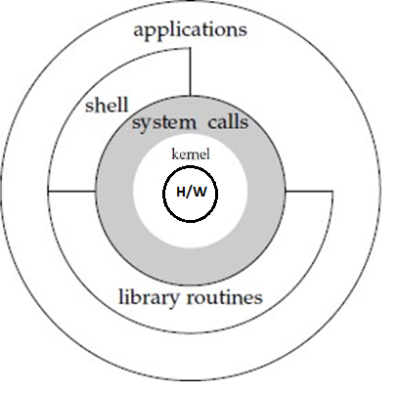
Architecture of the UNIX operating system
The core of the UNIX OS is called the kernel.
The kernel directly interacts with the hardware and provides services to the applications
The interface to the kernel is a layer of software called the system calls .
A system call is the programmatic way in which a computer program requests a service from the kernel of the operating system on which it is executed[1]
Libraries of common functions are built on top of the system call interface, but applications are free to use both.
The shell is a special application that provides an interface for running other applications.
For example, Linux is the kernel used by the GNU operating system.

Slide 16
History of Unix
1969-71 AT&T Bell Labs
MULTICS: Multiplexed Information and Computing Service
Mainframe-TimeSharing- MULTICS was used to mange Time-sharing
AT&T Stopped the project
Side Project was developed by the employees who were interested
MULTICS became a single user system UNICS (Uniplexed information and Computing Service)
UNICS was modified to support multiple users and eventually became Unix (x for multiple users)
1972: Unix was rewritten in C
Unix became portable to other hardware

Slide 17
History..
1975 –US govt bans AT&T from making any software
AT& T gave away free software (Unix) to almost anyone who requested for it -Universities, Govt agencies and Corporations
A number of mainframes were now running on Unix
First public version in 1975 is referred to as system 5 Open Source
BSD, Linux
Closed Source (Solaris, AIX etc) Proprietary HPUX
Mixed Source (Mac OS / Darwin)
IOS, ANDROID

Slide 18
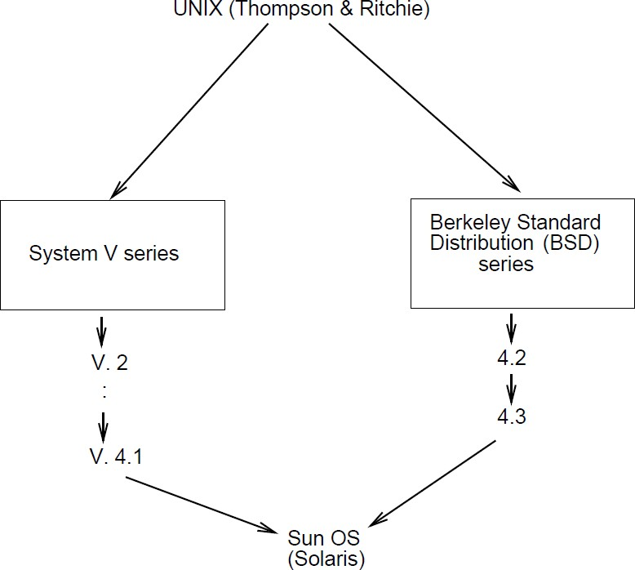
Classic versions
Two (classic) popular versions of Unix :
BSD (Berkeley Standard Distribution) Unix: introduction of Socket (Academics-Oriented)
System V: from Bell Laboratories (Industry-Oriented)

Slide 19
Other implementations of Unix
FreeBSD: post BSD line after UCB decided to end work on BSD versions. Both binary and sources of the FreeBSD are freely available
Linux: Freely available under GNU public license. Created in 1991, by Linus Torvalds to replace Minix
Became extremely popular( E.g., Debian, Ubuntu), in particular
it is widely used on servers and mainframe computers
Android is built on top of the Linux kernel

Slide 20
Where is Linux widely used?
Webservers
Linux is used to power 96.3% of the world's top 1 million web servers. Windows (1.9%), and FreeBSD 1.8%) are the other players: https://www.enterpriseappstoday.com/stats/linux-statistics.html
Single Board Computers (Raspberry Pie)
Android uses a modified version of the Linux Kernel
macOS is based on a BSD Unix kernel known as Darwin which is open-source.
iOS is a variant of Darwin, derived from BSD, a UNIX-like kernel
Supercomputers
https://en.wikipedia.org/wiki/TOP500
List of the fastest supercomputers in the world.

Slide 21
Other implementations of Unix..(Proprietary)
AIX: (Advanced Interactive eXecutive), IBM’s own version of Unix
HP-UX: Hewlett-Packard Unix.

Slide 22
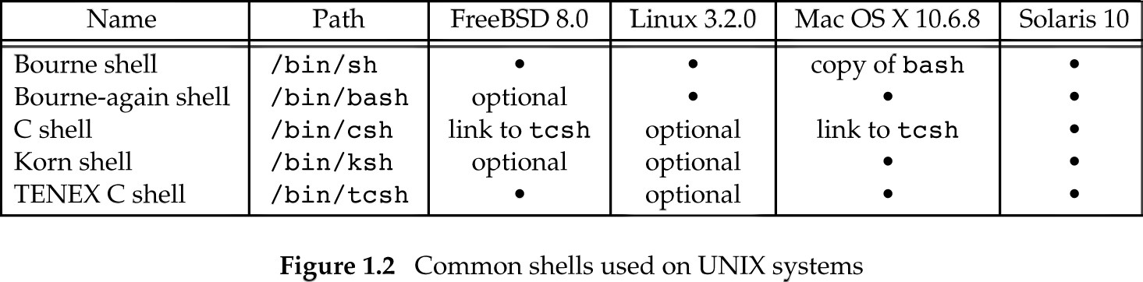
Shells
A shell is a command-line interpreter that reads user input and executes commands.
The user input to a shell is normally from the terminal (an interactive shell) or sometimes from a file (called a shell script).

Slide 23
//Current Shell //Various shells supported by the system $ cd / $ cd bin $ ls *sh -1 //Get the Version of Linux $ uname –a
$ echo $SHELL

Slide 24
Unix Essential Training Due: Sep/19/2023
Unix Essential Training: (See the lab section in Brightspace)
https://www.linkedin.com/learning-login/share?account=2212217&forceAccount=false&redirect=https%3A%2F%2Fwww.linkedin.com%2Flearning%2Funix-essential-training%3Ftrk%3Dshare_ent_url%26shareId%3DnHIsKhovToqnR9nuQigrsQ%253D%253D

Slide 25
FILE SYSTEM

Slide 26
File System
The UNIX file system is a hierarchical arrangement of directories and files.
Everything starts in the directory called root, whose name is the single character /
A directory is a file that contains directory entries. Logically, we can think of each directory entry as containing a filename along with a structure of information describing the attributes of files and other directories.
The attributes of a file are such things as the type of file (regular file, directory), the size of the file, the owner of the file, permissions for the file (whether other users may access this file), and when the file was last modified.
The stat function returns information containing all the attributes of a file.
$ denoted by the ~ symbol
$ stat sample.c cd / $ cd home $ cd pranga
Home directory is

Slide 27
Filename
The only two characters that cannot appear in a filename are the slash character (/) and the null character.
Characters are CASE-SENSITIVE
The slash separates the filenames that form a pathname and the null character terminates a pathname.
For portability, POSIX.1(Portable Operating System Interface-IEEE standard) recommends restricting filenames to consist of the following characters: letters (a-z, A-Z), numbers (0-9), period (.), dash (-), and underscore ( _ ).
Two filenames are automatically created whenever a new directory is created: .(called dot) and .. (called dot-dot).
$ cd ..
$ cd .
Dot refers to the current directory, and dot-dot refers to the parent directory. In the root directory, dot-dot is the same as dot.

Slide 28
Pathname
A sequence of one or more filenames, separated by slashes and optionally starting with a slash, forms a pathname.
A pathname that begins with a slash is called an absolute pathname; otherwise, it’s called a relative pathname. Relative pathnames refer to files relative to the current directory.
The name for the root of the file system (/) is a special-case absolute pathname that has no filename component.

Slide 29
Absolute and Relative Pathnames and Other file operations
$ cd Music
$ cd /home/pranga/Music
//Moving files from one folder to another
// cp, mv and rm
$ cp hello.c Music // Keeps the original file after copying
$ mv hello.c Music //Removes/deletes the original file after moving
$ cd Music
$ rm hello.c //Permanently deletes the original file
//Rename hello.c to helloworld.c
$ mv hello.c helloworld.c

Slide 30
Working Directory
Every process has a working directory, sometimes called the current working directory.
pwd //Print Working Directory
This is the directory from which all relative pathnames are interpreted.

Slide 31
Home Directory
When we log in, the working directory is set to our home directory.
$cd $cd ~

Slide 32
INPUT AND OUTPUT

Slide 33
Input and Output
Standard Input, Standard Output, and Standard Error
By convention, all shells open three descriptors whenever a new program is run: standard input, standard output, and standard error.
If nothing special is done, as in the simple command ls
then all three are connected to the terminal.
Most shells provide a way to redirect any or allof these three descriptors to any file.
For example, ls > listing.txt executes the ls command with its standard output redirected to the file named listing.txt
(use < for input redirection, >> for concatenation of output)

Slide 34
PIPES

Slide 35
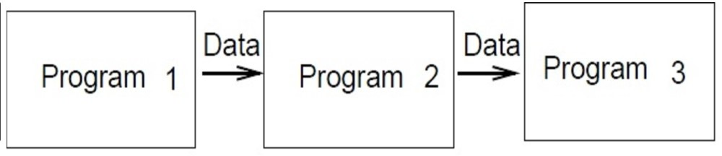
Pipes
Pipes : a mechanism that allows the user to specify that the output of one program is to be used as the input of another program.
– several programs can be connected in this fashion to make a pipeline of data owing from the first process through the last one.
Example :
Ls -1 | grep .c | wc -w

Slide 36
PROCESSES AND PROCESS ID

Slide 37
Processes and Process ID
An executing instance of a program is called a process. (Some operating systems use the term task to refer to a program that is being executed).
The UNIX System guarantees that every process has a unique numeric identifier called the process ID. The process ID is always a non- negative integer.
Try ps(Process Status)
Every process has a process id, parent process id and group id.

Slide 38
Process ID, Parent ID, Group ID
#include <stdio.h>
#include <unistd.h>
// processids.c
//process id, parent id, process group id
main(void)
{
printf("\n The current process id is %d \n",getpid());
printf("\n The parent id of the current process is %d \n",getppid());
printf("\n The group id of the current process is %d \n",getgid());
}

Slide 39
Three Important Process- Related Operations
fork() //Used to create a new child process
exec() //Used to replace a child process with a new process
waitpid() // Used to wait for a process to complete execution

Slide 40
User ID
The user ID from our entry in the password file is a numeric value that identifies us to the system.
This user ID is assigned by the system administrator when our login name is assigned, and we cannot change it.
The user ID is unique for every user.
The kernel uses the user ID to check whether we have the appropriate permissions to perform certain operations.
We call the user whose user ID is 0 as the superuser. The entry in the password file normally has a login name of root, and we refer to the special privileges of this user as superuser privileges.

Slide 41
A simple C program that prints the userid using the getuid() system call
// userid.c
//uses getuid() system call
#include <stdio.h> #include <unistd.h> main(void) { printf("\nThe current userid is %d\n",getuid()); }

Slide 42
SIGNALS

Slide 43
Signals
Signals (Software Signals) are used to notify a process of the occurrence of some condition.
For example, the following generate signals :
A division by zero : the signal SIGFPE is sent to the responsible process that has three choices. Ignore the signal, terminate the process or, call a function to handle the situation.
The Control-C key : when pressed, it generates a signal that causes the process receiving it to interrupt.
Calling the function kill : a process can send a signal to another process causing its death. This is an example where Unix checks our permissions before allowing the signal to be sent.
A number of signals can be used along with the kill command: $ kill –l

Slide 44
Kill Processes – Example
Run Multiple Processes and Kill Processes
$ ps –u
$ kill - (signo) Processid
$Kill –l //List of all signals

Slide 45
SYSTEM CALLS AND LIBRARY FUNCTIONS

Slide 46
System calls and library functions
“In computing, a system call is the programmatic way in which a computer program requests a service from the kernel of the operating system on which it is executed” [1]
Each system call in Unix has an interface function, in the C standard library, with the same name that the user process invokes.
The interface function then invokes the appropriate kernel service, using whatever technique is required on the system.
An interface function for a system call cannot be re-written/overridden by the user
For our purpose, a system call will be viewed as a regular C function.

Slide 47
System Calls- Common Examples
Open()
Read()
Write()
Close()
Fork()
Exec()
Exit()
Getpid()
Getgid()
Getuid()
--
--
--

Slide 48
A simple C program that prints the current process id using the getpid() system call
// pid.c
//uses getpid() system call
#include <stdio.h> #include <unistd.h> main(void) { printf("\nThe current process id is%d\n",getpid()); }

Slide 49
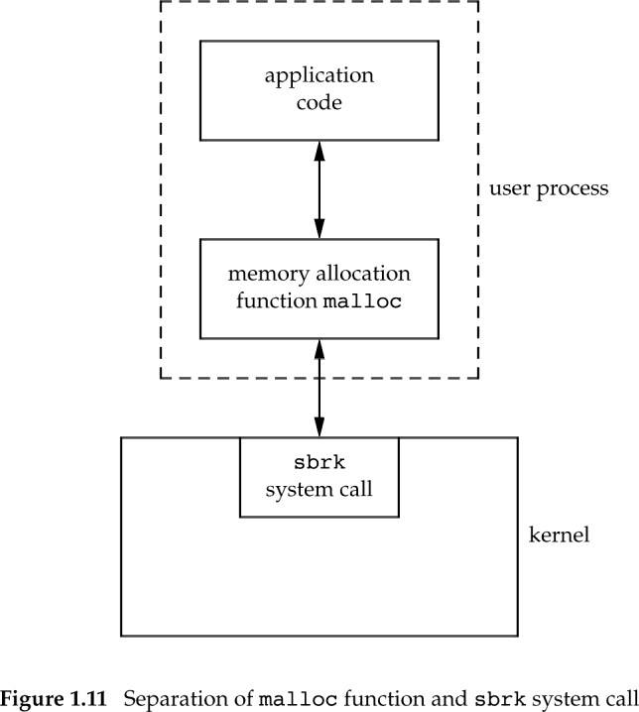
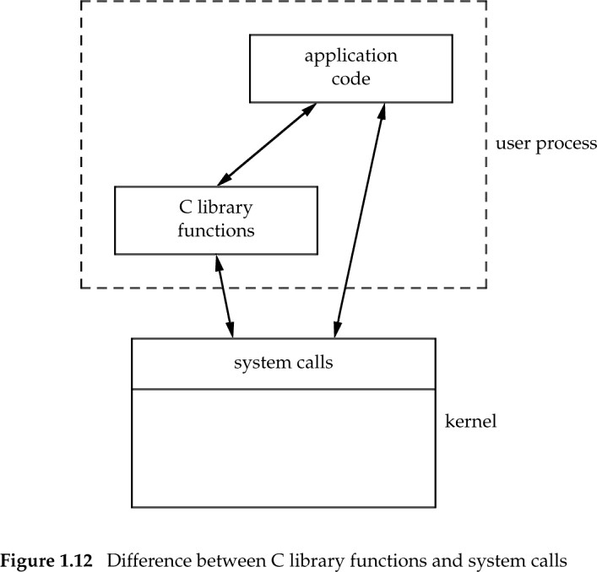
System calls and library functions
The functions which are a part of standard C library are known as Library functions: printf(), scanf(), strcmp(), strlen() etc are library functions.
Note that a user process can invoke either a system call or a library function.
A library function might invoke a system call.

Slide 50
Summary
Operating system: Software to manage computer resources, in particular,
it runs a program for a user
it allows communication with devices and processes
A program is a fille containing instructions
A process is a program being executed
Unix is a multiuser operating system
Most of Unix is written in the C language
Unix has a simple philosophy: a program should do one thing and do it well.
Entry points in Unix are called system calls. They allow the user to get services from the kernel.

Slide 51
Unix Essential Training Due: Sep/14/2023
Unix Essential Training: (See the lab section in Brightspace)
https://www.linkedin.com/learning-login/share?account=2212217&forceAccount=false&redirect=https%3A%2F%2Fwww.linkedin.com%2Flearning%2Funix-essential-training%3Ftrk%3Dshare_ent_url%26shareId%3DnHIsKhovToqnR9nuQigrsQ%253D%253D

Slide 52
APPENDIX

Slide 53
Linux
6.3.1 (Apr/30/2023 –SR
6.4-rc1 (May/07/2023 –PR)
version 11 (Debian)
The current stable distribution of Debian is version 11, codenamed bullseye. It was initially released as version 11.0 on August 14th, 2021 and its latest update, version 11.7, was released on April 29th, 2023. {debian.org)

Slide 54
Where is Linux used?
Webservers
Linux is used to power 96.3% of the world's top 1 million web servers. Windows (1.9%), and FreeBSD 1.8%) are the other players: https://www.enterpriseappstoday.com/stats/linux-statistics.html
Single Board Computers (Raspberry Pie)
Android uses a modified version of the Linux Kernel
macOS is based on a BSD Unix kernel known as Darwin which is open-source.
iOS is a variant of Darwin, derived from BSD, a UNIX-like kernel
Supercomputers
https://en.wikipedia.org/wiki/TOP500
List of the fastest supercomputers in the world.

